Slide 1

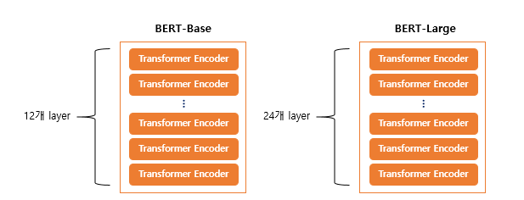

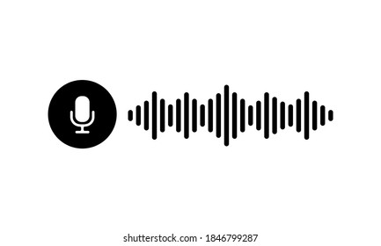

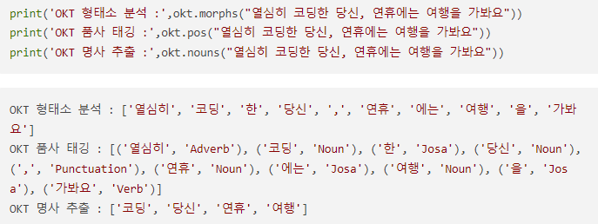
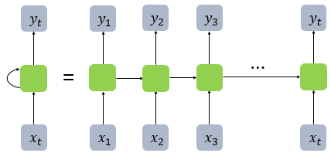

Real-time voice
Voice phishing Data
BERT
New Data
Train
Test
STT
(Speech To Text)
Tokenization
Deep Learning Algorithm
Text
WARNING!

